Slide 1
Philosophy Essay Writing (adapted from presentation by Year 12 Chief Examiner)

Slide 2
Problems with Essay Writing
Many students do not answer the question. For example, rather than addressing the question ‘does Descartes provide a convincing case for dualism?’ they instead provide a detailed exposition of all of Descartes’ arguments.
Many students struggle to relate the arguments and viewpoints expressed within the set texts to the set topic.
Many essays are indiscriminate – rather than relevant arguments and viewpoints from the set texts used to support discussion of the question, students outline all of the arguments.

Slide 3
Problems with Essay Writing
Outlines are superficial. Many students struggle to ‘walk the reader through’ the reasoning for a given conclusion.
Many students really struggle with evaluation. Often students will spend the majority of time on outlining an argument and only give cursory attention to evaluation.
Rather than evaluating the arguments in terms of the question, students often simply evaluate the arguments generally.

Slide 4
Problems with Essay Writing
In 2016, the average score on the essay section of the exam was 9.6/20

Slide 5
Qualities of a Good Essay
Clearly written
Logically organised.
Demonstrates in-depth knowledge of concepts, arguments, viewpoints and ‘big ideas’ and understands the relationship between these and the prompt
Includes what is necessary to answer the question and nothing extraneous.

Slide 6
Qualities of a Good Essay
Uses relevant, concrete examples
Engages in detailed analysis
Provides sophisticated, developed, persuasive evaluations
Demonstrates personal engagement with the ideas

Slide 7
Essay Structure
You should use the first person
In this essay I will argue that changes in a person’s physical body does not alter their essential self…
The purpose of this essay is to consider why John Stuart Mill believes that ….. and to establish why this is not a satisfactory response to this criticism…
I reject Hume’s claim that…

Slide 8
Essay Structure
Your essay must be very well structured and logical. Use signposting to highlight when you move to a new argument or point.
Michaels’ dememoriser case is as follows:
In order to understand Swinburne’s theodicy, we must first make clear exactly what constitutes moral evil…
I will first outline Locke’s memory criterion for identity…
Avoid becoming repetitive though. You don’t always need to start a paragraph with ‘I will now…’

Slide 9
Essay Structure
Assume the reader knows nothing about the cases and examples you explore. You will need to fully outline and explain concepts
Locke’s memory criterion for the persistence of personal identity over time is as follows:
John Stuart Mill holds that there are qualitative differences between pleasures. He suggests that….
The Buddhist doctrine of anatta states that…

Slide 10
Essay Structure
It can be really impressive if you include your own examples to illustrate a point / your own analogies / your own cases
If we imagine a world where our every move is controlled by God. Every apparent ‘choice’ or ‘decision’ you make is illusory, be it something to wear, what to study or…
Consider the following case: a man returns home drunk…
This is the kind of tone we’re after

Slide 11
Essay Structure
Take up a clear position on the issue/topic and then proceed to offer reasons and arguments to your reader for why they should share your position.
Invite them to share your position. If we consider…. It therefore becomes clear that… When we realise that…

Slide 12
Essay Structure
Introductions

Slide 13
Essay Structure
Introductions:
Work best when they are direct and concise.
Give a brief overview of this area of philosophy / ‘break the ice’. Others prefer to get straight to the topic/issue at hand. Either is fine. Nevertheless, some unpacking of the topic/issue is needed. eg. A common criticism of utilitarianism is that it is a doctrine worthy only of pigs. This is because…
Clearly state your contention - what your position is in relation to the set topic (eg. give your conclusion)
Phrases like these help to do this: The purpose of this essay is to… / In this essay I will argue that…

Slide 14
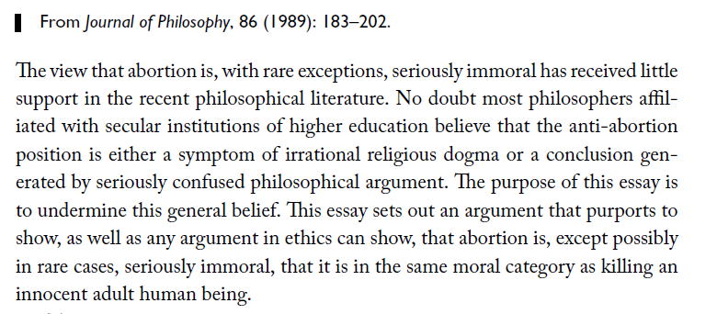
Essay Structure
Introductions:

Slide 15
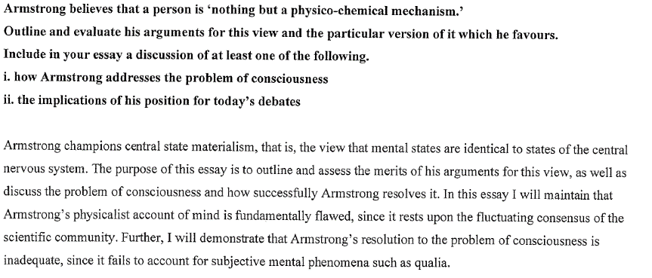
Essay Structure
Introductions (Billanook 2013)

Slide 16
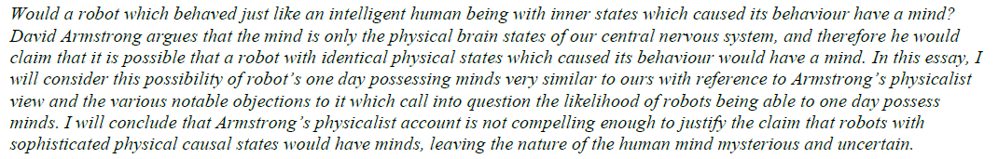
Essay Structure
Introductions (high scoring essay from 2011 examiners report)

Slide 17
Essay Structure
Body Paragraphs

Slide 18
Essay Structure
Body Paragraphs:
Build your argument – present arguments in support of your view
Carefully outline arguments you intend to analyse – ‘walk the reader through the steps of the argument’
Clearly signpost these arguments (without being repetitive…)
Be sure to include developed evaluations / critical comparisons too

Slide 19
Essay Structure
Body Paragraphs:
Provide examples, metaphors and analogies to help illustrate your views (eg. To suggest that this is the same person is like suggesting that an a corn is the same thing as a fully grown oak tree…)
Present the other side of this issue and rebut possible responses to your position
Draw on / quote other philosophers and state why you reject such a view

Slide 20

Essay Structure
Body Paragraphs:

Slide 21
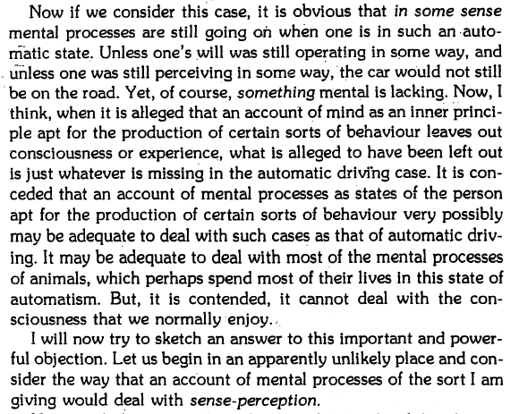
Essay Structure
Body Paragraphs:

Slide 22
Essay Structure
Body Paragraphs:
You can signpost your arguments without relying on too many ‘I will now do XYZ…’ statements.
The next criticism of Locke’s memory theory I will examine is Thomas Reid’s Brave Officer Paradox. It is as follows: … Secondly, Thomas Reid’s Brave Officer paradox is a popular counter-example to Locke’s memory theory. It is as follows: …
I will now provide an example to illustrate why Locke’s theory is the most compelling. Another clear advantage of Locke’s theory can be seen when we consider the following example.

Slide 23
Essay Structure
Conclusion

Slide 24
Essay Structure
Conclusion:
Clearly restate your contention / view
State what you think you’ve achieved in the essay I have shown that… I have argued that… It has been established that… The purpose of this essay has been to…

Slide 25
Essay Structure
Conclusion:

Slide 26
Essay Structure
Conclusion:
Sample Student Conclusion
This essay has provided an application of Swinburne’s theodicy in light of the recent tragedy experienced in Boston. I have shown that Swinburne’s argument provides us with a workable and logically sound account for why an all-powerful and all-good God would leave open the possibility of such acts of horror. We therefore need not abandon belief in such a God when such tragedies occur. It has been demonstrated that living in a world where we possess FRC, where our choices and actions have a real impact on the world and on others lives is preferable to a world where we do not possess this free will. Further, it is now clear that one makes a logical contradiction when suggesting that God could both intervene and prevent such acts of moral evil and give us FRC.

Slide 27
Final Tips
Leave one or two lines between paragraphs – it makes the essay look better aesthetically.

Slide 28
Final Tips
Nice turns of phrase:
Perhaps… / On the other hand… / Conversely… / Moreover… / Furthermore… / Further… / Let us consider…
Some people suggest that X, to the contrary; Y is…

Slide 29
Assessment Criteria
I will use the same criteria the examiners use when assessing student essays (25 marks)
Expression 1-5
Knowledge and understanding 1-5
Identification and analysis of relevant material 1-10
Development and evaluation 1-5
http://www.vcaa.vic.edu.au/Documents/exams/philosophy/2013/philosophy_examrep13.pdf (pages 9 & 10)

Slide 30
Sample essay topics
Consider the case of the Teleporter. Is the person who steps out at the destination end the same person who stepped in at the departure end? Critically compare Locke and Hume’s likely answer to this question.
‘A sceptical view of the self has disastrous consequences for our treatment of others and moral responsibility. Do you agree? Make reference to any two of the philosophers studied in this unit.
‘Memory is the most significant factor in the problem of personal identity.’ Do you agree? Make reference to any two of the philosophers studied in this unit.
In May of last year German state police arrested a 93-year-old man, Hans Lipschis. He was accused of being a guard at the Auschwitz concentration camp 69 years earlier and being complicit in the murders that took place there. Should he be held morally responsible? Make reference to at least two philosophers studied in this unit.
The theory of self we adopt has direct implications for the way we understand life, and death. Discuss with reference to any two of the philosophers studied in this unit.

Slide 31
‘Memory is too problematic for us to consider it the source of personal identity through time.’ Do you agree? Make reference to any two of the philosophers studied in this unit.

Slide 32
How do Hume and Locke differ in their accounts of the role of memory in personal identity? Whose account do you find most appealing and why?

Slide 33
If a philosopher’s account of personal identity has objectionable moral consequences, that is sufficient reason to reject it. Do you agree? Make reference to any two of the philosophers studied in this unit.

Slide 34
Many have noted a striking similarity between Hume’s position and the Buddhist view of the self. Which do you feel is superior? Why?

Slide 35
Consider Meredith Michaels’ case of Dr Nefarious and his dememoriser; ‘Tomorrow at 5:00 you will be horribly tortured…(but) tomorrow at 4:58 I am going to erase all of your memories and implant in your brain all of Ronald Reagan’s memories. Isn’t it true that at 5:00 you will undergo horrible torture, while believing you are Ronald Reagan? Aren’t you still worried about what will happen to you at 5:00? Look at your fingernails while you consider your answer to this question.’
Which of the Unit 3 philosophers do you believe provides the most appropriate answer to this question?

Slide 36
Critically Compare
The essay topics will invite critical comparison of the philosophers studied in Unit 3.
Remember ‘critically compare’ means:
(1) You must provide some account of each philosopher’s view on the role of pleasure in the good life. (2) You must note the similarities and differences between the philosophers’ views. (3) Finally, you must provide some comparative evaluation of these views.

Slide 37
Critically Compare
Critically compare the views of Callicles and Aristotle on the role of pleasure in the good life.
Callicles believes that pleasure is synonymous with a good life. By allowing our desires to expand (which he believes is in line with our natures) we can experience more pleasure and therefore greater happiness.
Aristotle would agree that pleasure comes naturally to us, but he would disagree that it is synonymous with the good life because he disagrees with Callicles on what human beings are. According to Aristotle, we are defined by reason. Thus a good life is one in which we use our reason to navigate our response to pleasure, rather than allowing our actions to be driven by it. He also believes that we ought to have been raised and educated in order to take pleasure in the things that we ought to.

Slide 38
Critically Compare
Both philosophers see pleasure as something that human beings are drawn to naturally. But whilst Callicles endorses a life free of restraint from any pleasure, Aristotle believes that self-control is critical to living a good life. For him, our rationality can provide this self-control and we must overcome our natural tendency toward pleasure. At first glance, the life Callicles endorses that is devoted to pleasure seems like it would be quite enjoyable and it fits with the fact that it is in our nature to enjoy pleasure (eg. children enjoy what is pleasurable), but upon more serious reflection we see that it would ultimately leave a person miserable. Take, for example, a night of heavy drinking at a birthday party. Callicles would advocate this activity, but it would surely lead to unhappiness, particularly if a person did something they regret whilst under the influence. Aristotle’s approach, applying our reason to pleasure and identifying a more moderate level of celebration will help us to avoid such unhappiness.

Slide 39
Let’s have a go at critically comparing using this model
Critically compare the way in which Socrates and Aristotle believe we can go about choosing the right thing to do throughout our lives.
(1) You must provide some account of each philosopher’s view on the role of pleasure in the good life. (2) You must note the similarities and differences between the philosophers’ views. (3) Finally, you must provide some comparative evaluation of these views.

Slide 40
Compare Terms/Phrases
Unlike X, Y focusses more on…
Similarly, …
On the other hand, …
In stark contrast, …
Whilst X shares Ys view that z is important, X is more focussed on how z can…
Taking a different approach, …
X agrees with Y that…
Both philosophers agree that…
Neither philosopher feels that X is important to living well…

Slide 41
Critically Compare Tip
Rather than simply saying which approach you think is better, couch your evaluation in terms of the good life.
eg. Whilst Xs approach to living well has the potential to lead a person towards contentment, Ys approach will ultimately leave a person empty and unfilled. Thus, Xs advice for how to live well is superior.

Slide 42
Critically Compare Essay Structure
Point of difference / similarity with comparative evaluation
Introduction
Account of both philosophers positions in relation to the topic (should include ‘comparison terms’ at least)
* Point of difference / similarity with comparative evaluation
Point of difference / similarity with comparative evaluation
Conclusion

Slide 43
Assessment Criteria
Key knowledge
• viewpoints and arguments on the nature of the good life in the set texts;
• similarities and differences between the viewpoints and arguments on the nature of the good life in the set texts;
• objections and criticisms that can be raised when critically comparing the set texts’ viewpoints and arguments on the good life to each other.
Key skills
• outline philosophical viewpoints using appropriate terminology;
• recognise arguments, identifying the premises and conclusions, and the relationship between the premises and conclusion of each argument;
• critically compare philosophical viewpoints and arguments by comparing the plausibility of the premises or viewpoints, any assumptions made, reasoning used, and/or the potential consequences for the good life;
• offer justified critical responses to philosophical viewpoints and arguments using clear and precise language.

