Slide 1
The Media Crisis
Andrew Lorimer
July 2019

Slide 2
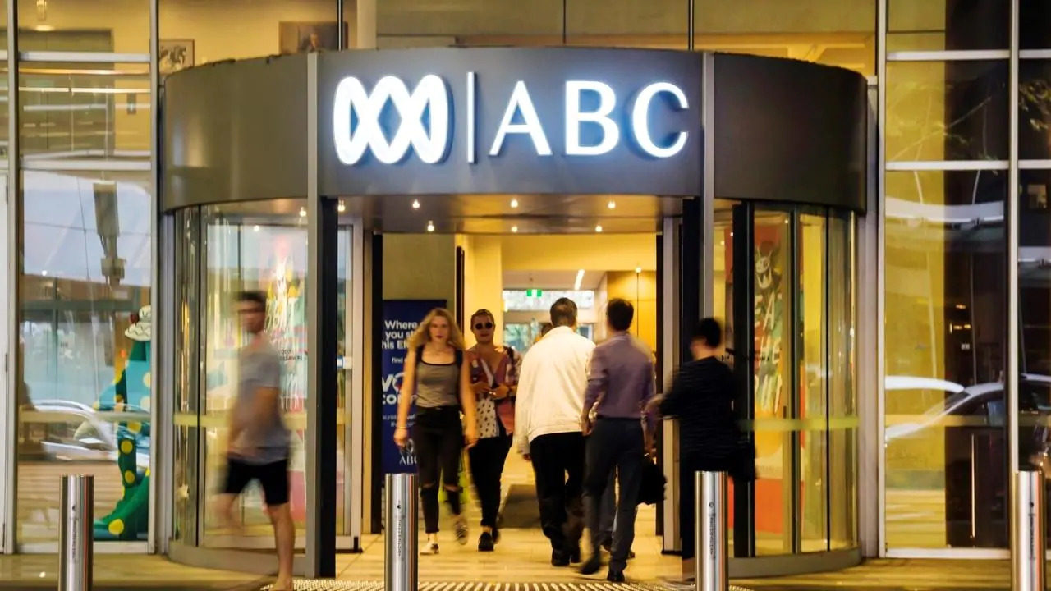
Image: Public Media Alliance

Slide 3
Source confidentiality

Slide 4
“interactions with sources
are the nuts and bolts
of being a reporter”
Anthony Funnel, ABC

Slide 5
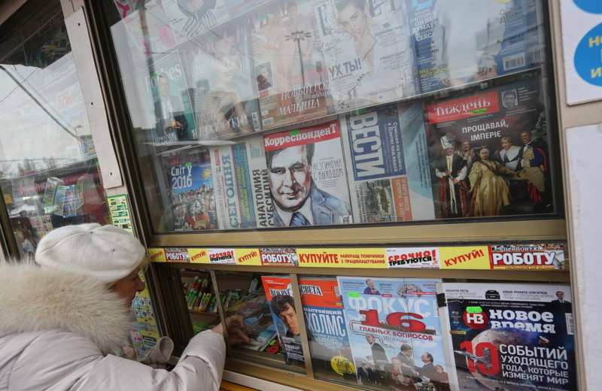
Ukraine, 2018
Image: Борис Kovačić

Slide 6
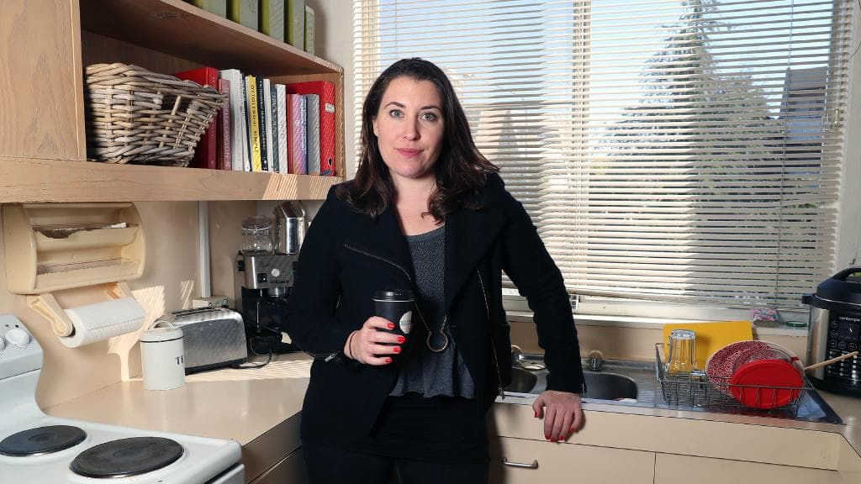
Annika Smethurst
Image: AP

Slide 7
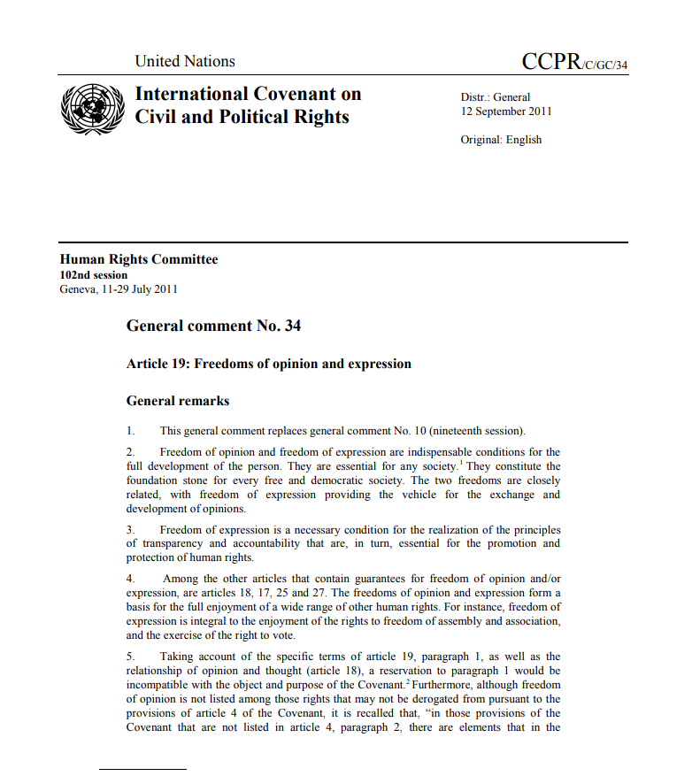

Slide 8
“Every individual should have the right to ascertain […] what personal data is stored in automatic
data files, and for what purposes”
UN Covenant on Civil and Political Rights

Slide 9
“The free communication of information and ideas about public and political issues is essential.
This implies a free press able to comment on
public issues and to inform public opinion
without censorship or restraint.”
Adapted from UN Covenant on Civil and Political Rights

Slide 10
“Journalism should be more like science. As far as possible, facts should be verifiable. If journalists want long-term credibility for their profession, they have to go in that direction. Have more respect for readers.”
Julian Assange

Slide 11
References
  [1] Ananian-Welsh, Rebecca (5 June 2019). “Why the raids on Australian media presents a clear threat to democracy”. The Conversation.
  [2] Mann, Monique (15 August 2018). “The devil is in the detail of government bill to enable access to communications data”. The Conversation.
  [3] Azoulay, A; UNESCO (2018). “World trends in freedom of expression and media development: global report 2017/2018”. ISBN 978-92-3-100242-7.
  [4] Parker, Samuel (2015). “‘Unwanted invaders’: The representation of refugees and asylum seekers int he UK and Australian print media”. Cardiff University.
  [5] Rosen, Jay (12 June 2019). “Key steps in the citizens agenda style of campaign coverage”. PressThink. Carter Journalism Institute, New York University.
  [6] Morris, Gaven (28 September 2018). “ABC’s independence is our most precious asset”. ABC News.
  [7] Lyons, John (15 July 2019). “AFP raid on ABC reveals investigative journalism being put in same category as criminality”. ABC News.
  [8] Images used under Creative Commons license from Public Media Alliance, Борис Kovačić, and Associated Press

