Slide 1
The Media Crisis
Andrew Lorimer
July 2019

Slide 2
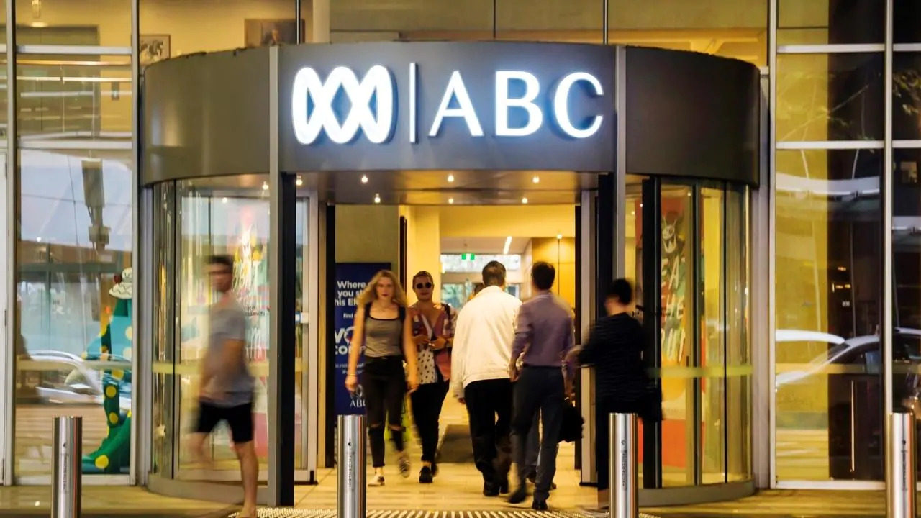

Slide 3
Source confidentiality

Slide 4
“the nuts and bolts
of being a reporter”
Anthony Funnel, ABC

Slide 5
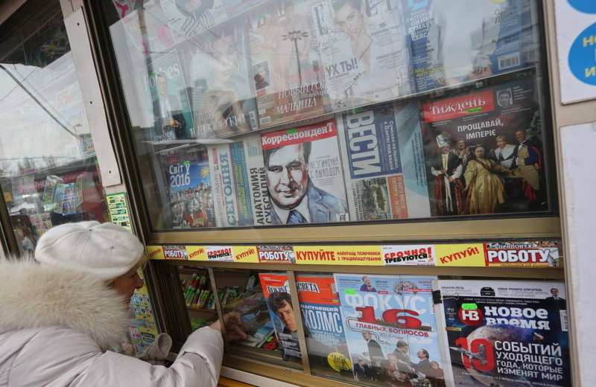

Slide 6
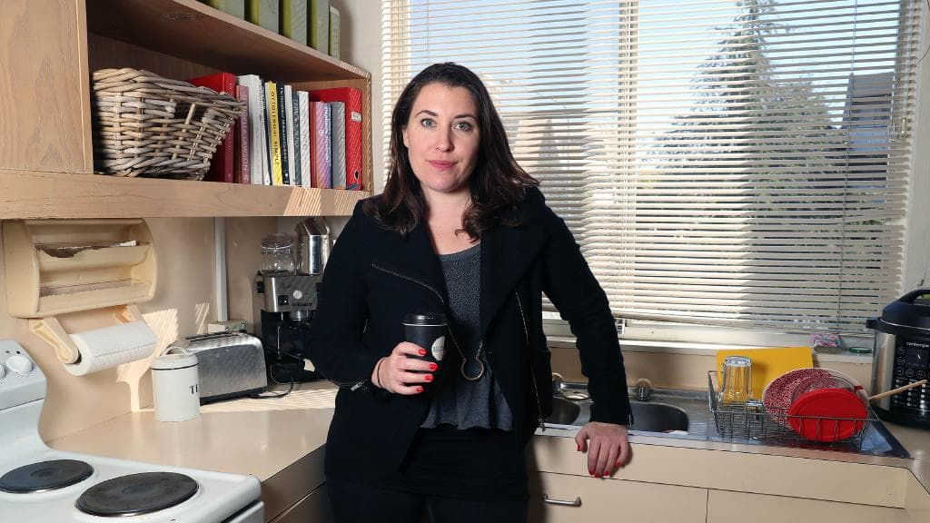

Slide 7
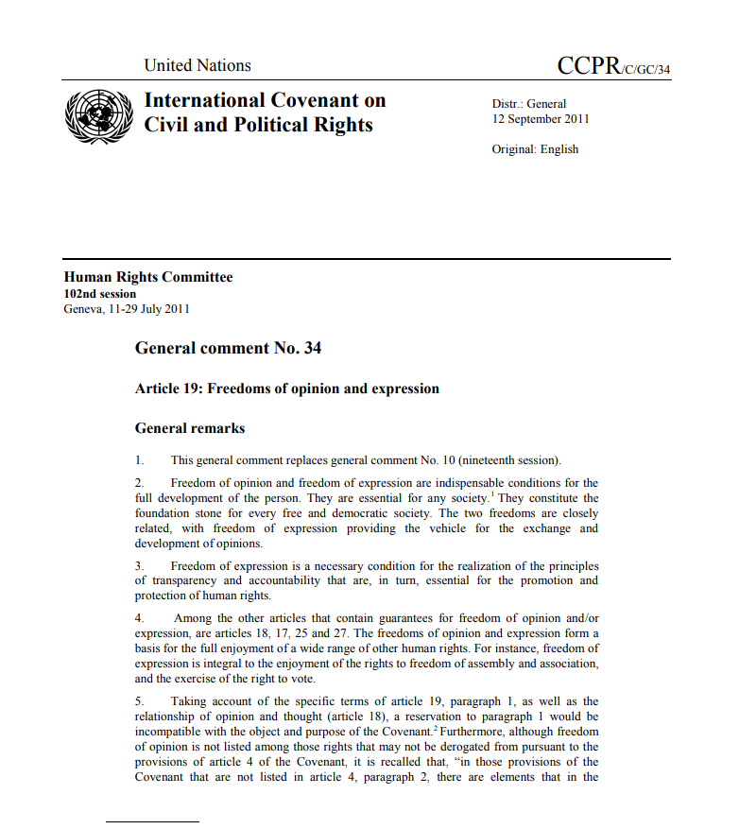

Slide 8
“Every individual should have the right to ascertain in an intelligible form, whether, and if so, what personal data is stored in automatic data files,
and for what purposes”

Slide 9
“The free communication of information and ideas about public and political issues between citizens, candidates and elected representatives is essential. This implies a free press and other media able to comment on public issues and to inform public opinion without censorship or restraint.”

Slide 10
“Journalism should be more like science. As far as possible, facts should be verifiable. If journalists want long-term credibility for their profession, they have to go in that direction. Have more respect for readers.”
Julian Assange

Slide 11
References
  [1] Ananian-Welsh, Rebecca (5 June 2019). “Why the raids on Australian media presents a clear threat to democracy”. The Conversation.
  [2] Mann, Monique (15 August 2018). “The devil is in the detail of government bill to enable access to communications data”. The Conversation.
  [3] Azoulay, A; UNESCO (2018). “World trends in freedom of expression and media development: global report 2017/2018”. ISBN 978-92-3-100242-7.
  [4] Parker, Samuel (2015). “‘Unwanted invaders’: The representation of refugees and asylum seekers int he UK and Australian print media”. Cardiff University.
  [5] Rosen, Jay (12 June 2019). “Key steps in the citizens agenda style of campaign coverage”. PressThink. Carter Journalism Institute, New York University.
  [6] Morris, Gaven (28 September 2018). “ABC’s independence is our most precious asset”. ABC News.
  [7] Lyons, John (15 July 2019). “AFP raid on ABC reveals investigative journalism being put in same category as criminality”. ABC News.
  [8] Images used under Creative Commons license from Australian Broadcasting Corporation and Kyiv Post.

